Slide 1
Command line & Spark introduction
September 2018

Slide 2
Topics
Command line
Access & basic commands
Useful to know
Example script
Hadoop & hive
Distributed computing
Hadoop & hive from command line
Moving data (CL & hive)
Spark
Spark introduction
Practicalities
Example notebook
Starting a jupyter notebook
Loading & saving
Parsing an SQL query
Working with dataframes
UDFs
Graphs

Slide 3
Access & basic commands
Ssh access
ssh gw001.hadoop-csi-mn.ams1.cloud
Ssh access with port forwarding (necessary for using jupyter notebooks)
ssh -L 8833:localhost:8833 gw001.hadoop-csi-mn.ams1.cloud (where 8833 can also be another port)
Basic commands
cd – Change Directories. cd ~ ...
ls – List Directory Contents. ls -l. ...
cp – Copy a File, More Uses. cp -r /home/user/pics /home/user2/ ...
mv – Move and Rename Files. ...
chmod – Change Permissions. ...
rm – Remove a File (Delete) ... (Caution!!)
grep – Search Files or Output. ...
tail – Display End of a File.
pwd – Print working directory
Text editors
Nano (easiest), vim, emacs

Slide 4
Usefull to know
Usefull to know
Ctrl+R lets you recursively search your own commands
Tab complete
Locations
Absolute path: from ‘root’. / at start of location means from root
Relative path: from pwd.
~ is home
Home on our gateway: /media/home/<username>/
A word of caution
Linux does not ask you ‘are you sure?’ !!
Be careful when:
Removing files. What do you think rm –rf does?
Moving data. Never move sensitive information to the wrong place, if you are unsure, try with a test file!

Slide 5
Example script
Example script
Running the script
Change permission: chmod u+x myscript.sh
Run: ./myscript.sh
Passing arguments from command line
In script: $1
From command line: ./myscript.sh ‘Cat’
#!/bin/bash
# Script to print hello world
echo Hello World
Notes:
Shebang #!/bin/bash

Slide 6
Distributed computing
Hadoop & Hive
For more on hadoop & hive, see this presentation
Hadoop
Notes:
Distributed computing
Versus traditional databases.
Hadoop
Hive
Language built on top of hadoop in order to query data. Turns Hive QL into mapreduce jobs

Slide 7
Hadoop & Hive from command line
Warning: do not move sensitive data if you are not sure where it will end up. Test it first!
All of these are executed on the gateway.
Hive
Locations on hadoop
User folder: /user/<username>
Hive tables: /user/hive/warehouse/<database>.db/<table> (Distributed!)
Hadoop
hadoop fs -ls | Read hadoop filesystem
hadoop fs –put <origin> <destination> | Put file in hadoop filesystem
hadoop fs –get <origin> <destination> | Get file from hadoop filesystem
hive –f <query>.hql | Execute hive query (in file)
hive –e ‘select * from <database>.<table>’ | Execute query (in string)
hive | Interactive mode
Notes:
Show this.
Setup hive from CMD!
hive -e 'select * from elobker.ad_aggregate_sample limit 10;'

Slide 8
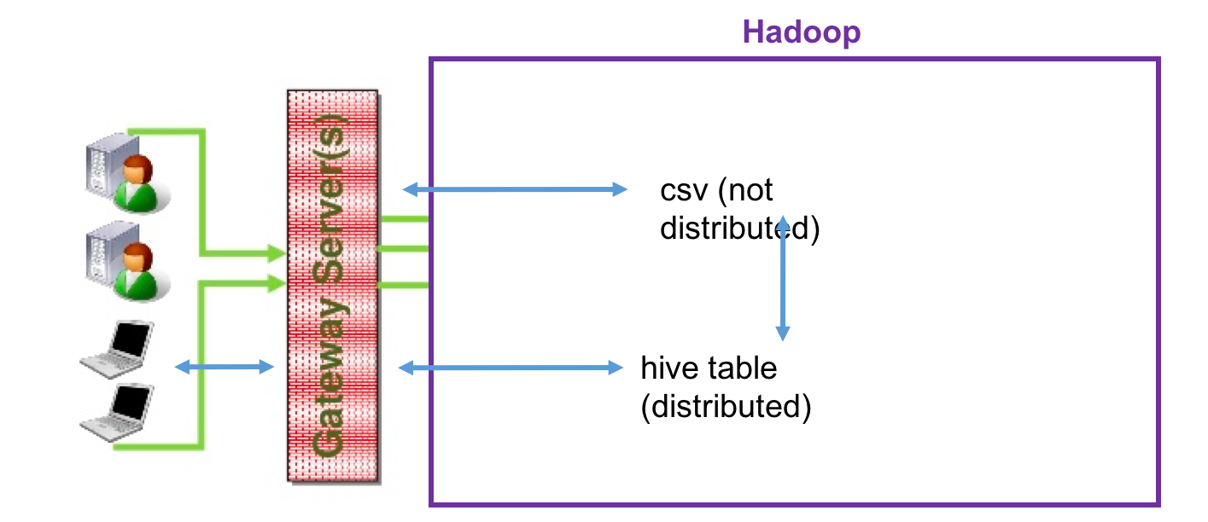
Moving data (using CL / hive)
2
1
3
1. Local computer – Gateway
scp gw001.hadoop-csi-mn.ams1.cloud:/media/home/<username>/${1}.gz ${2}
2. Gateway – csv on hadoop (not distributed)
hadoop fs –get <origin> <destination>
hadoop fs –put <origin> <destination>
3. Csv on hadoop (not distributed) -> hive table (distributed) with hive
create table <database>.<table> (col_name data_type);
load data inpath ‘/user/<username>/<filename>’ overwrite into table <database>.<table>;
3. Hive table (distributed) -> csv on hadoop (not distributed) with hive
hive -e "select * from <database>.<table>;” > ”hdfs://nameservice1/user/<username>/<filename>"
4. Csv on gateway -> Hive table (distributed) with hive
create table <database>.<table> (col_name data_type);
load data local inpath ‘/media/home/<username>/<filename>’ overwrite into table <database>.<table>;
4. Hive table (distributed) -> Csv on gateway with hive
hive -e "select * from<database>.<table>;" | sed 's/[\t]/,/g’ > ”<filename> "
4
Notes:
You can put these in a bash script :D
testdata_spark_cmd.csv
Show
scp
hadoop –put
hadoop -get
python create_move_data
hive –f write

Slide 9
Spark – introduction
What is Spark?
Spark versus Hive
Hive is an SQL-like interface to query data stored in Hadoop
Spark is a computing framework
Spark Dataframes
Queries with syntax similar to python pandas
Functionality to parse SQL query
Lazy Dataframes
Executed only when needed
Executed again when not persisted
Interplay between memory and disk
Default memory & disk: cache, persist.
Default memory: collect (and of course toPandas)
Warning: only do toPandas, collect etc. when the data will fit in memory!
Notes:
Distributed computing
Versus traditional databases.
What is Spark?
Distributed computing framework
Can work ‘on its own’ or on e.g. hadoop
Can use it with languages R, Python, Scala
Spark versus Hive
Hive is a computing language built on top of hadoop. Spark is a computing framework, which can work on it’s own, or be on top of hadoop.
What is faster depends on your settings (memory etc), what you are trying to compute, how you stored your data, etc.
When to use which;
Spark is useful for automation; e.g. CDATA automates spark jobs. It can achieve additional optimization compared to Hive.
You can use spark SQL, or Spark Dataframes (like python pandas). Advantage of using dataframes is that python is an object oriented programming language, which has it’s advantages.
Spark can be a bit tricky to debug, it is still under heavy development.
When using Spark SQL, Hive and Spark are very similar in use.
Spark SQL and Spark DataFrames
They are ‘lazy’, only compute when necessary. -> Show some commands for this!

Slide 10
Spark - practicalities
Kernel
See kernel file
Put this in the location .local/share/jupyter/kernels/pyspark/kernel.json
Change the user name to your own username
Resource settings
"PYSPARK_SUBMIT_ARGS": "--conf spark.dynamicAllocation.enabled=false --master yarn --num-executors 5 --driver-memory 1g --executor-memory 10g --executor-cores 2 pyspark-shell"
Resources are blocked while the notebook is running. Exit if you do not use them.
--num-executors * --executor-cores = Number of cores. Our queue has 700 in total. Please be modest in use, 200 max for all your running notebooks. You need much less for most things.
--num-executors * --executor-memory = Used memory. Our queue has 6000 GB in total. Please be modest in use.
Resource manager
Check how many resources you and others are using
http://hadoop-mn003.ix5.shared.prod.st.ecg.so:8088/cluster/
Notes:
Explain the context of queue

Slide 11
Spark – example notebook
Starting a jupyter notebook
jupyter notebook --no-browser --ip=0.0.0.0 --port=8845
Go to desired directory -> new -> PySpark
Notes:
Opens where you execute the command, cannot go ‘up’ in directories
Port has to be the same as the port you defined in your ssh command
Spark SQL cheat sheet
https://s3.amazonaws.com/assets.datacamp.com/blog_assets/PySpark_SQL_Cheat_Sheet_Python.pdf
Pyspark SQL module documentation
http://spark.apache.org/docs/2.3.1/api/python/pyspark.sql.html
Pyspark SQL, DataFrames and Datasets programming guide
http://spark.apache.org/docs/latest/sql-programming-guide.html

Slide 12
Other topics
Where am I?
Good to know
Trouble shooting

Slide 13
Where am I?
ssh gw
hadoop fs –ls
Hive tables
jupyter notebook
HiveContext.sql(“””select * from database.table”””)
toPandas
Hadoop

Slide 14
Good to know
Memory management with hive
set mapreduce.map.memory.mb=; set mapreduce.reduce.memory.mb=;
Running pyspark from command line:
.bashrc
export PYTHONPATH=/var/lib/cloudera/parcels/SPARK2/lib/spark2/python/
export SPARK_HOME=/var/lib/cloudera/parcels/SPARK2/lib/spark2/
export PYSPARK_PYTHON=/usr/local/anaconda-py2/bin/python
export PATH=/usr/local/anaconda-py2/bin:$PATH
CL
spark-submit --master yarn --deploy-mode client --driver-memory 1g --executor-memory 10g --queue mp-hadoop --num-executors 10 --conf=spark.dynamicAllocation.enabled=false ./script.py <arg1> <arg2>

Slide 15
Trouble shooting
Resource manager does not load
In case it asks for a password; turn off your proxy. To do this; go to system preferences, network, proxies, advanced and uncheck box. This proxy is only needed for accessing the PET system.
Failed to find authentication when using hive or pyspark
Use kinit <username>@ECG.SO
No permission to run script
Change permissions (chmod u+x myscript.sh)
Copied code from this presentation complains about syntax errors
The “ does not copy correctly from powerpoint / word etc to command line. Replace them with the ‘straight’ ones.

